Slide 1
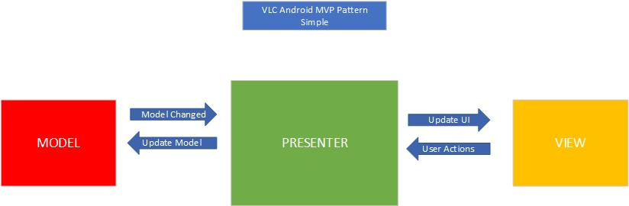
MVP Architecture for VLC Android
Why does MVP (Model View Presenter) work as good architecture for VLC android?

Slide 2
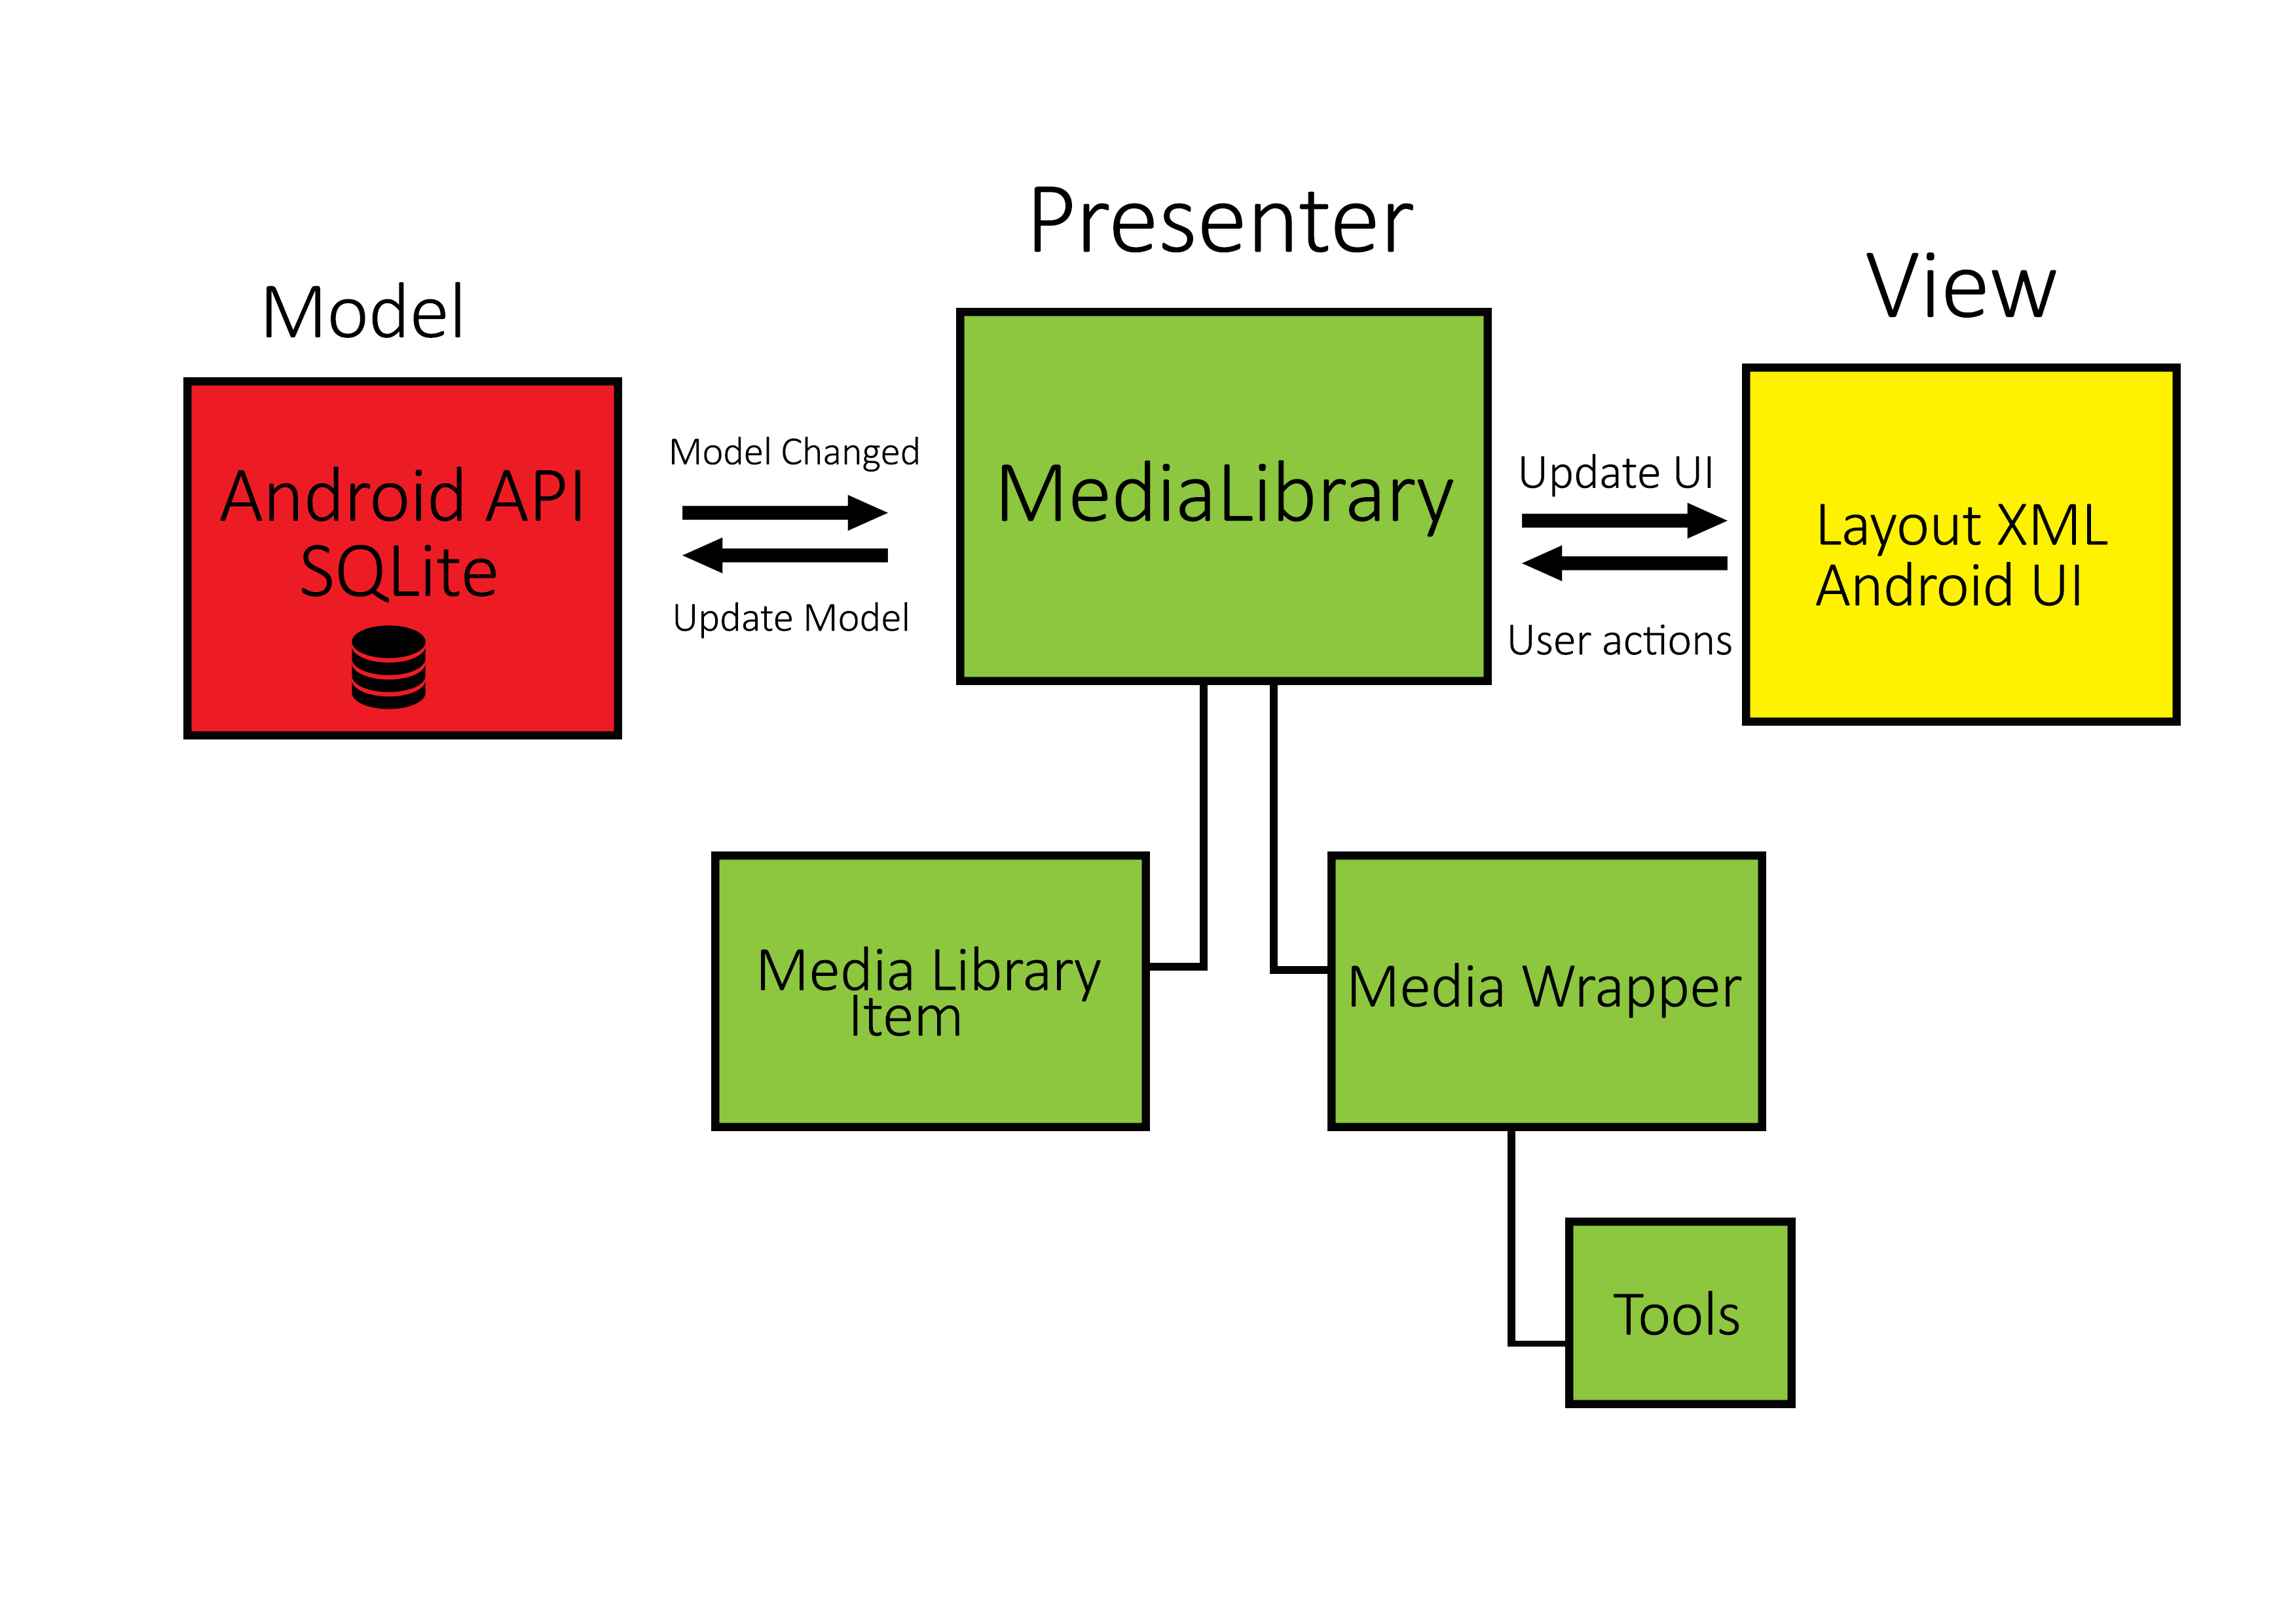
MVP Architecture for VLC Android

Slide 3
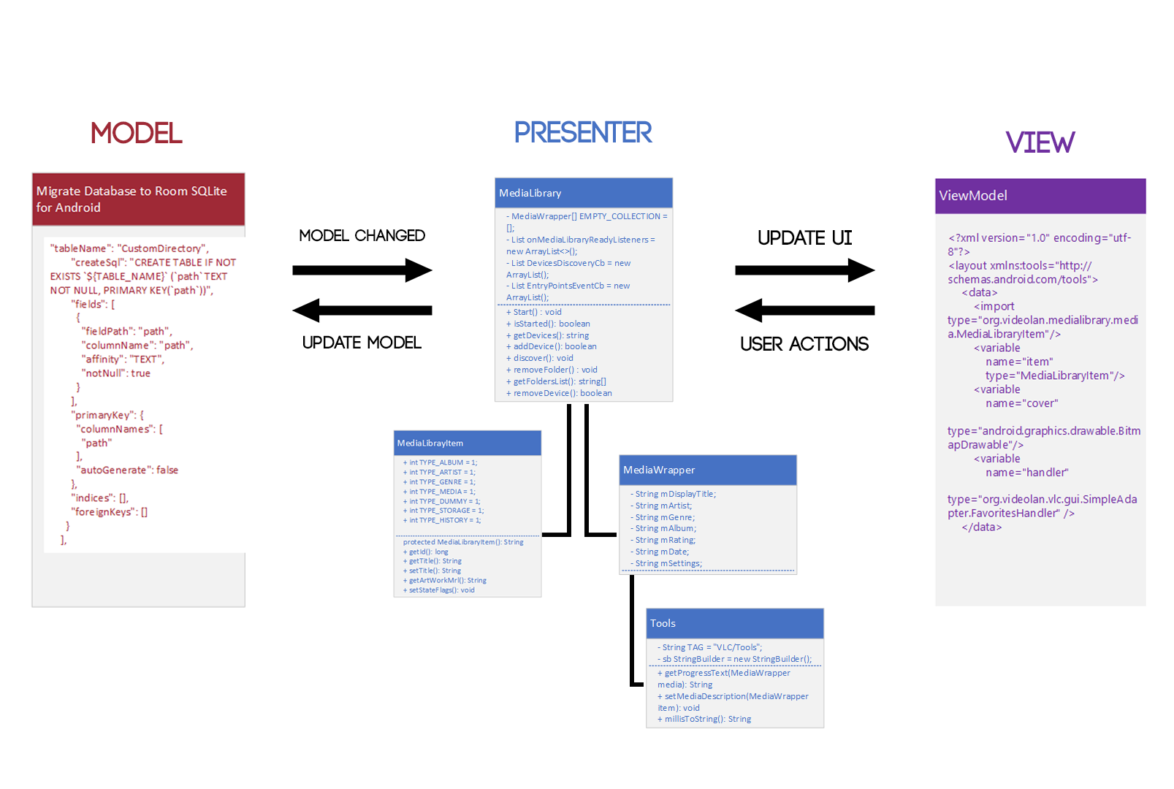
MVP Architecture for VLC Android

Slide 4
MVP Architecture for VLC Android
The model consists of two parts. Local Database and Androids SQLite API service.
This architecture style is mainly used for UI applications such as VLC android

Slide 5
MVP Architecture for VLC Android
The view uses androids ‘Layout’ service.
This uses Androids XML vocabulary to quickly design UI layouts.

Slide 6
Negatives of MVP architecture structuring
Requires more time and effort and structuring of code.
It can become very complicated as the presenter is the main chunk of the program and contains most of the logic.
The aim of MVP is to simplify but it can do the opposite.

Slide 7
Quality Aspects of VLC android
Testability
100 million downloads on google play; 7 years of different devices

Slide 8
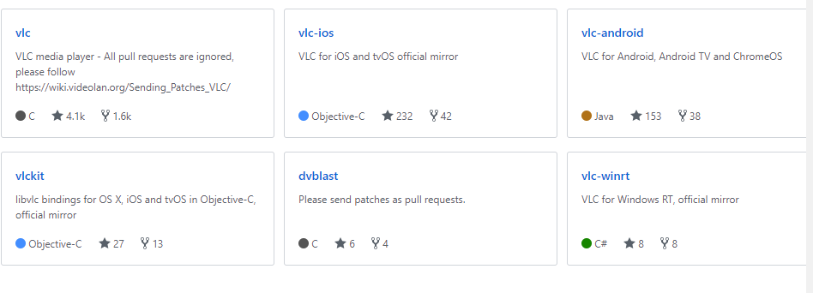
Quality Aspects of VLC android
Portability – the result of open source

